Slide 1
Embedded System for Real-time Medical Data Monitoring, Collection and Medication Administration (Internet Programming Project)
Ulvi Bajarani and Gwendolyn Poulos
Summer 2020
The University of Texas Rio Grande Valley

Slide 2
Project Overview
Diastolic BP threshold detection in real time
Medication dispensation in real time.
Central management system that has databases that store data.
Website with real time views of specific tables

Slide 3
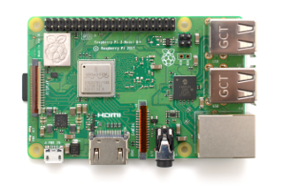
Raspberry Pi 3B+
The single-board computer.
Contains various ports for connections (Ethernet, USB, HDMI, etc.)
For the assignments, the port GPIO was used to test the sensors and actuators.
The genuine OS of the device that also is used in the project is Raspberry Pi OS (previously called Raspbian)

Slide 4
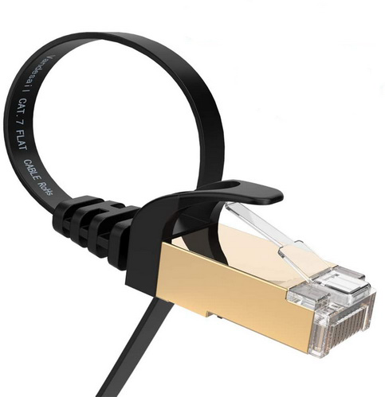
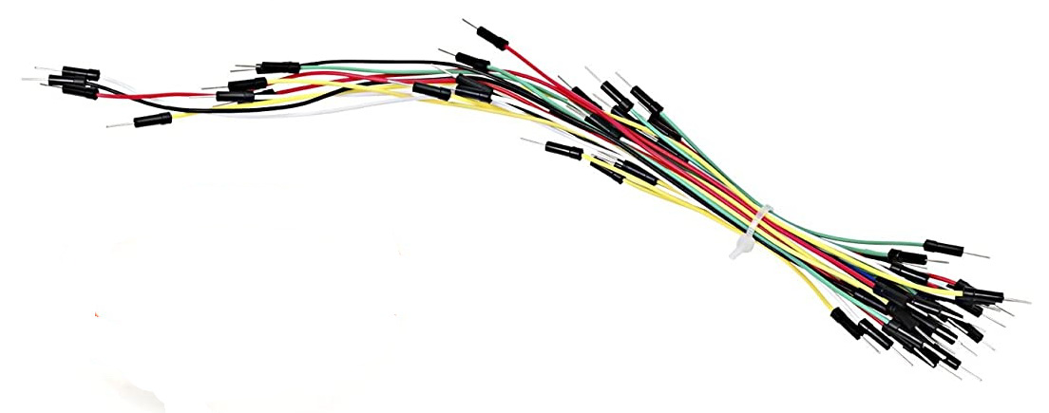
Accessories that used in the project together with the single-plate device.
Joystick

Slide 5
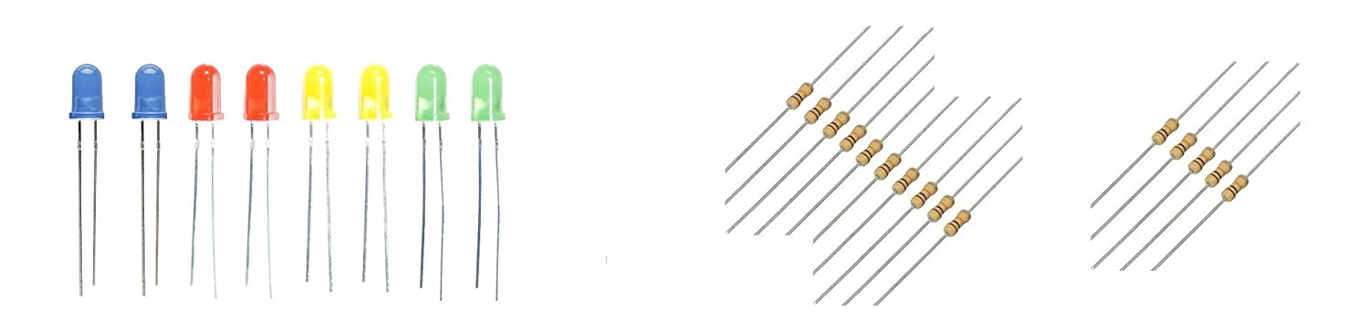
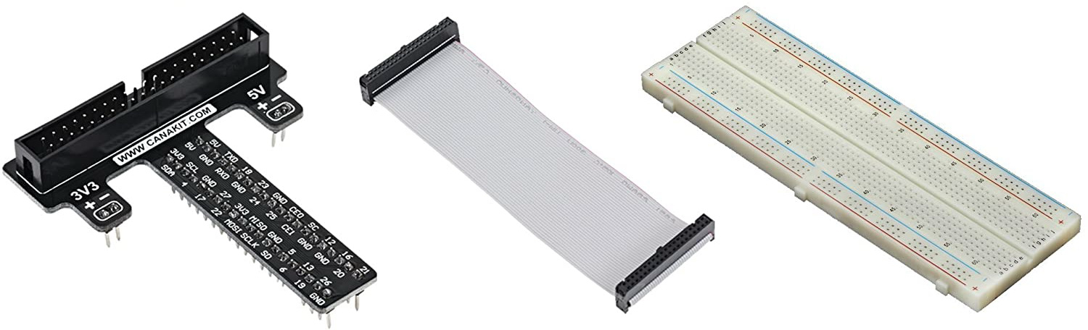
Accessories that used in the project together with the single-plate device (continued).
Joystick

Slide 6
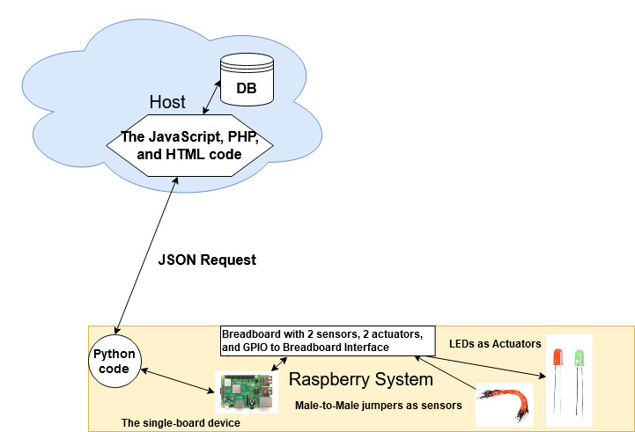
The system layout

Slide 7
Usage of Sensors and Actuators
SW1 switches automatically to 1 if the systolic blood pressure is higher than 120 mm Hg and remains 0 otherwise. The initial value is 0.
SW2 switches automatically to 1 if the diastolic blood pressure is lower than 60 mm Hg and remains 0 otherwise. The initial value is 0.
LED1 describes if norepinephrine is administered. Unlike sensors, might be switched to on/off manually.
LED2 describes if nitroglycerin is administered. Unlike sensors, might be switched to on/off manually.

Slide 8
Python Code Snippets (RPi)
while i<n:
LED1=GPIO.input(4) #read what BCM Pin #4 is set to (LED1)
LED2=GPIO.input(6) #read what BCM Pin #6 is set to (LED2)
SW1=GPIO.input(17) #read the status of BCM Pin #17 (SW1)
SW2=GPIO.input(22) #read the status of BCM Pin #22 (SW2)
data = {'username': 'Test', 'password': 'Tester3', 'SW1': SW1, 'SW2': SW2, 'LED1': LED1, 'LED2': LED2}
res = requests.post("https://team2project3342.online/scripts/sync_rpi_data.php", json=data)
r = res.json()
ts = datetime.datetime.now() #get the time stamp
print "==============Server Response at " + str(ts) + "=============="
if r['success']==1:
_x005F_x0001__x005F_x0001_ ...
print "The status of LED1 is " + str(r['LED1'])
print "The status of LED2 is " + str(r['LED2'])
print "The status of SW1 is " + str(r['SW1'])
print "The status of SW2 is " + str(r['SW2'])
else:
print ">>>>> Server request failed - Error #" + str(r['error'])
time.sleep(delay) #wait for delay seconds before sending another request
i+=1
GPIO.cleanup()

Slide 9
PHP Code Snippets for synchronization (RPi)
The part of sync_rpi_data.php, which connects the Python requests in RPi and the website.
if ($input)
{
$json = json_decode($input, true); //check if it json input
if (json_last_error() == JSON_ERROR_NONE)
{
if (isset($json["username"]) && isset($json["password"]) && isset($json["SW1"]) && isset($json["LED1"]) && isset($json["SW2"]) && isset($json["LED2"]))
{
$in_username = $json["username"]; $in_password = $json["password"]; //if the expected fields are not null, get them
$in_SW1 = $json["SW1"]; $in_SW2 = $json["SW2"];
$in_LED1 = $json["LED1"]; $in_LED2 = $json["LED2"];
if ($stmt = $mysqli->prepare("SELECT password FROM Users WHERE pname = ? LIMIT 1"))
{
$stmt->bind_param('s', $in_username);
$stmt->execute();
$stmt->store_result(); //store_result to get num_rows etc.
$stmt->bind_result($db_password); //get the hashed password
$stmt->fetch();
if ($stmt->num_rows == 1)
{ //if user exists, verify the password
if (password_verify($in_password, $db_password))
{
…

Slide 10
PHP Code Snippets for synchronization (Android)
The part of sync_rpi_android.php, which connects the Python requests in RPi and the website.
if ($stmt = $mysqli->prepare("UPDATE SensorsAndActuators set DeviceStatus=? where DevID = 'LED1'")) { //update LED1
$stmt->bind_param('i', $in_LED1); $stmt->execute();
if($in_LED1==1){
$check=1;
}
}
else {$error=1;}
$stmt->close();
if($check==1){
if ($stmt = $mysqli->prepare("INSERT INTO TransactionalLogs(TimestampInfo,MessageID,DataInformation) VALUES(?,?,?)")) { //Insert into log
$id='13';
date_default_timezone_set("America/Chicago");
$date=date("Y-m-d H:i:s");
$stmt->bind_param('sss', $date, $id,$in_username);
$stmt→execute(); }
$stmt->close();
$check=0; }

Slide 11
Kivy Code Snippets (Android)
event = Clock.schedule_interval(partial(self.JSONrequest),5)
…
data={'username':'Test', 'password':'Tester3','SW1':SW1,'LED1':LED1,'SW2':SW2,'LED2':LED2}
res=requests.post("https://team2project3342.online/scripts/sync_android_data.php",json=data)
print(res)
r=res.json()
if(SW1!=r['SW1']):
print("Changing SW1 status to the value in the database.")
if self.sw1.active==True:
self.sw1.active=False
self.led1.active=False
else:
self.sw1.active=True
if(SW2!=r['SW2']):
print("Changing SW2 status to the value in the database.")
if self.sw2.active==True:
self.sw2.active=False
self.led2.active=False
else:
self.sw2.active=True
return

Slide 12
Website Code Snippets
The login part in index.php
<div id="body">
<h3>Login</h3>
<form id="form1" method="post" action="">
<div>
<label for="usernm">Username: </label>
<input type="text" name="usernm" id="usernm" required><br><br>
</div>
<div>
<label for="psswrd">Password: </label>
<input type="password" name="psswrd" id="psswrd" required><br><br>
</div>
<button id="sub" type="Submit">Submit</button>
</form>
</div>

Slide 13
Website Code Snippets (continued)
The database connection part in index.php
<?php
if(isset($_POST['usernm']) and isset($_POST['psswrd'])){
$uname=$_POST['usernm'];
$passwrd=$_POST['psswrd'];
if($query = $mysqli->prepare("SELECT * FROM Users WHERE pname='$uname'")){
$query->execute();
$query->bind_result($username,$password);
$count=0;
while($query->fetch()){
$count=$count+1;
}
if ($count == 1){
if(password_verify($passwrd,$password)){
...
}
else{ //echo "Login Credentials verified"; echo "<script type='text/javascript'>alert('Login Credentials do not match')</script>";}
}
else{
echo "<script type='text/javascript'>alert('Invalid Login Credentials')</script>";
//echo "Invalid Login Credentials";
}
}
else{echo "Error in if 2";}
}
?>

Slide 14
Website Code Snippets (continued)
The refresh function in welcome.php
<script type="text/javascript" src="jquery.js"></script>
<script src="https://cdn.jsdelivr.net/npm/chart.js@2.8.0"></script>
<script type="text/javascript">
$(document).ready(function() {
setInterval(function() {
$('#status').load('DBdevice.php')
}, 3000);
});
</script>

Slide 15
Website Code Snippets (continued)
The DBDevice.php that retrieves the status of Sensors and Actuators and describes it in the site.
<?php
date_default_timezone_set("America/Chicago");
echo "Last update: " . date('m/d/y') . " " . date('h:i:sa') . "<br>";
echo "<h3>Status of Sensors and Acutators</h3>";
if ($stmt=$mysqli->prepare("SELECT * FROM SensorsAndActuators LIMIT 100")) {
$stmt->execute();
$stmt->bind_result($devid,$devtype,$devfun,$ctrl,$status);
echo "<table><tr><td>Device Name</td><td>Status</td></tr>";
while ($stmt->fetch()) {echo "<tr><td>$devid</td><td>$status</td></tr>"; }
echo "</table>";
$stmt->close(); }
else {
echo "error";
$mysqli->close();
}
...
?>

Slide 16
Website Code Snippets (continued)
The data.php that retrieves the data for the chart.
<?php
require_once __DIR__ . '/../required/db_connect.php';
$stmt = "SELECT MessageID, TimestampInfo FROM TransactionalLogs ORDER BY TimestampInfo";
$result = mysqli_query($mysqli,$stmt);
$data = array();
foreach ($result as $row){
$data[] = $row;
}
mysqli_close($mysqli);
echo json_encode($data);
?>

Slide 17
Website Code Snippets (continued)
The JavaScript code in Chart.php that creates the chart
<script src='https://cdn.jsdelivr.net/npm/chart.js@2.8.0'></script>
<script src='jquery.js'></script>
<script>
$(document).ready(function (){
showGraph();
});
function showGraph(){ {
$.post('data.php',
function(data){
console.log(data);
data=JSON.parse(data);
var time=[];
var mid=[];
for (var i in data){
time.push(data[i].TimestampInfo);
mid.push(data[i].MessageID);
} … } } </script>

Slide 18
Application
The Login system in the website.
The App could send not only the status of sensors and actuators, but also describe the status of alarms.
The chart describing the login activities

Slide 19
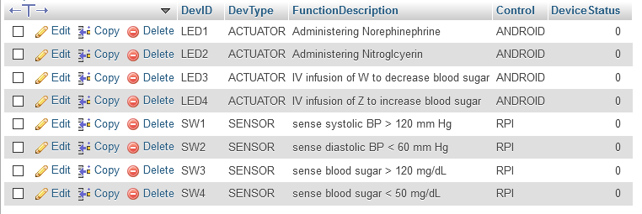
Database Tables
SensorsAndActuators

Slide 20
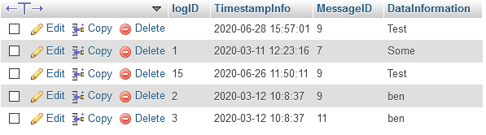
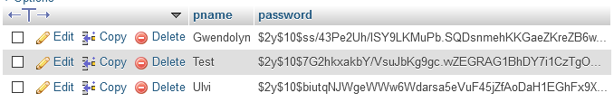
Database Tables (continued)
TransactionalLogs
Users

Slide 21
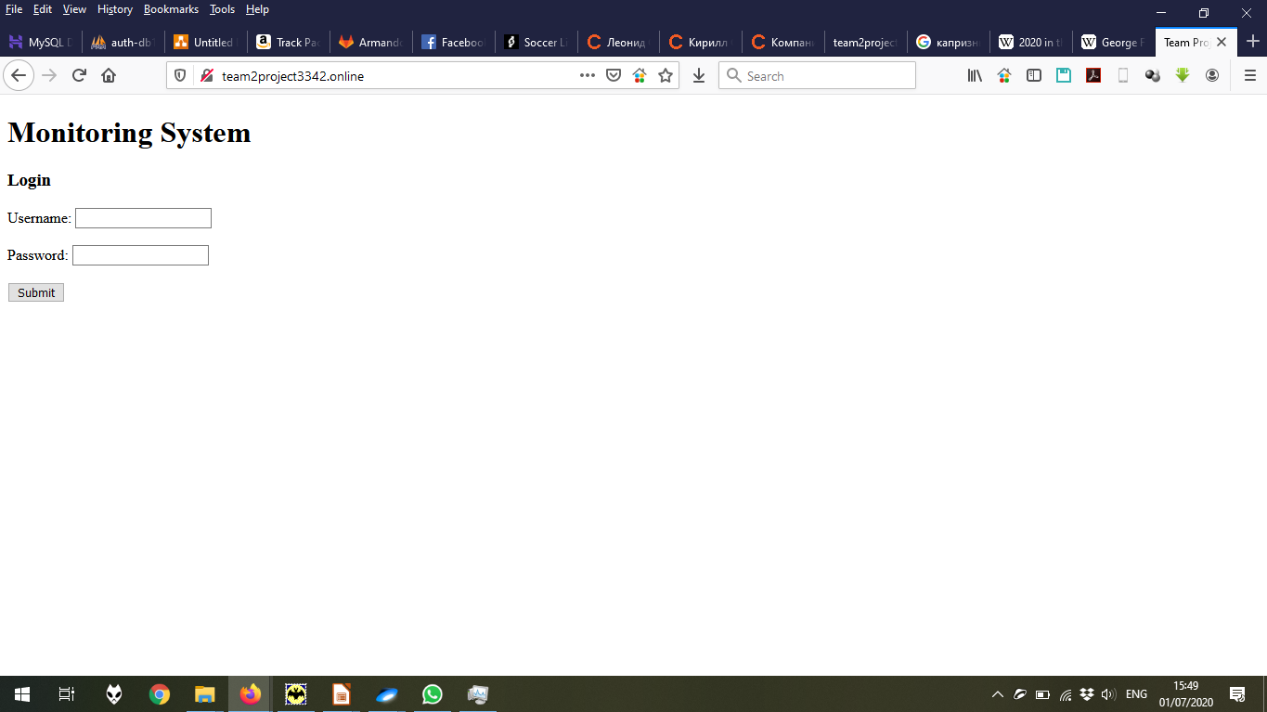
The login page

Slide 22
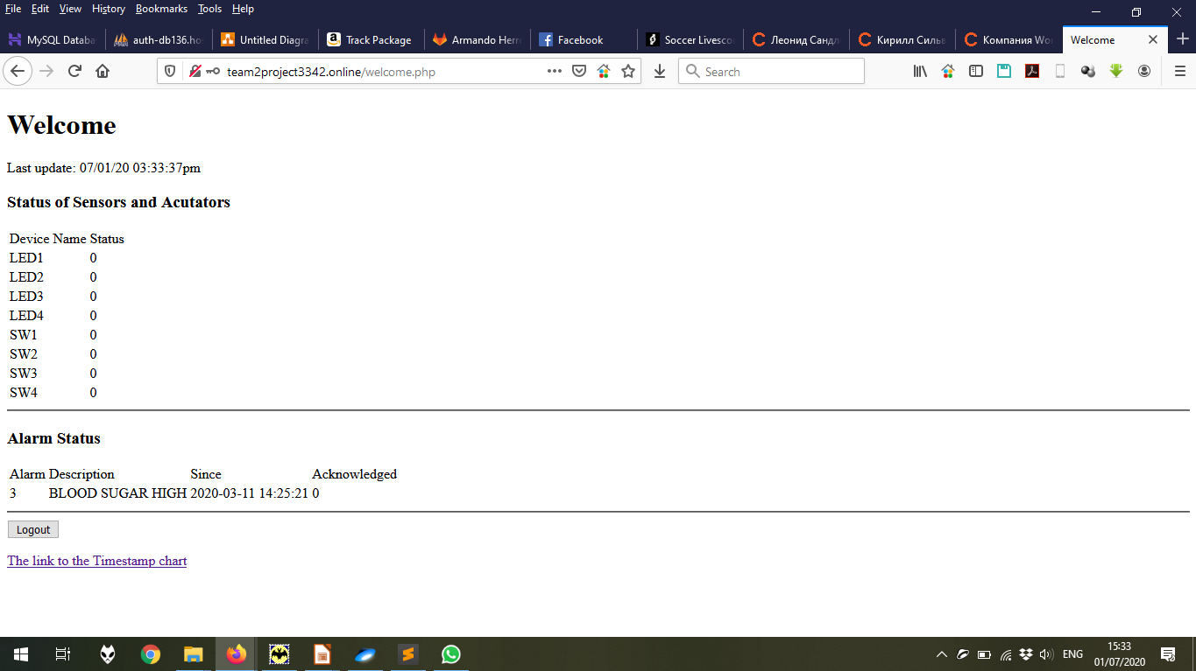
The page after logging in

Slide 23
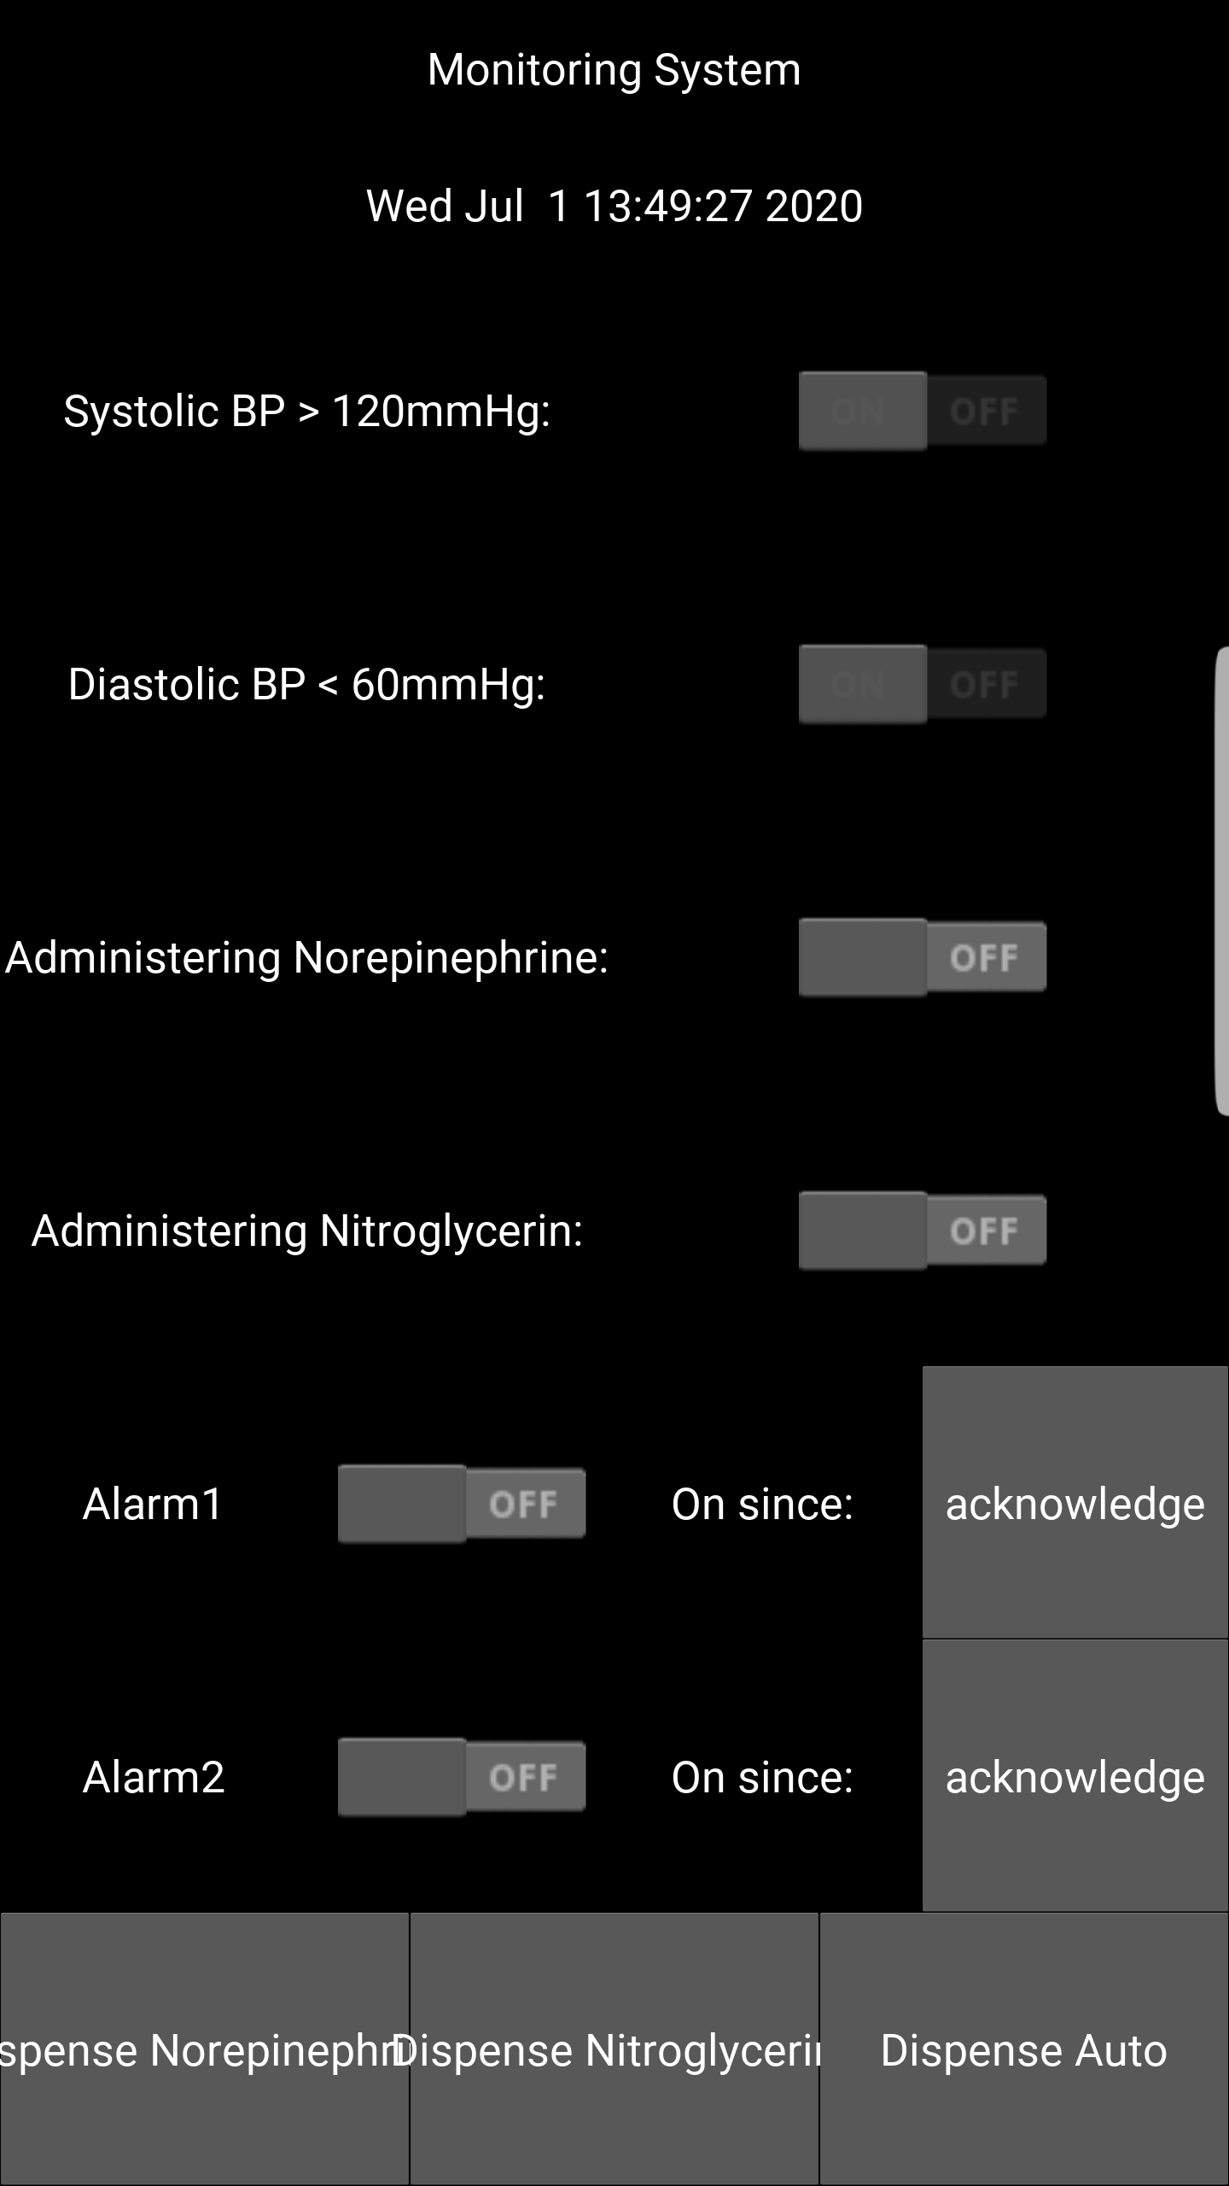
Android App View

Slide 24
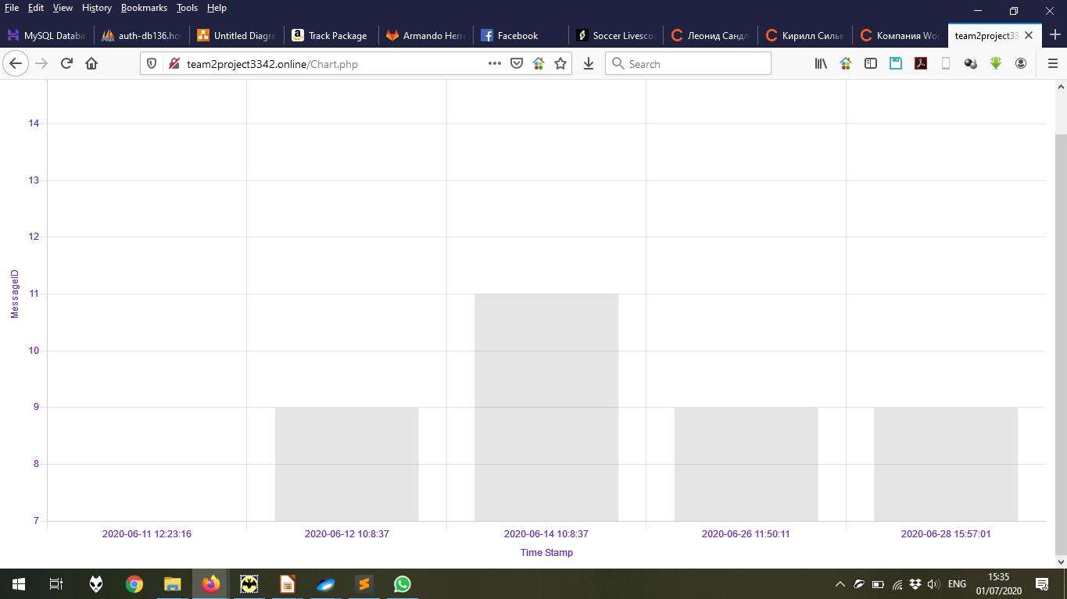
Results and Analysis
Due to the few data, the team were unable to conduct enough analysis. But it might be seen that the chart describes the login date and time, and the possible issues with the login is described by the MessageID.

Slide 25
Issues and Recommended Enhancements
Could be added more sensors and actuators for the sugar level;
The sensors could react to the values retrieved from the created form (for example, the people from the database);
In the chart, instead of messageID, the meaning of the message could be displayed;
The logout function should be reworked.
The site design should be reworked.

Slide 26
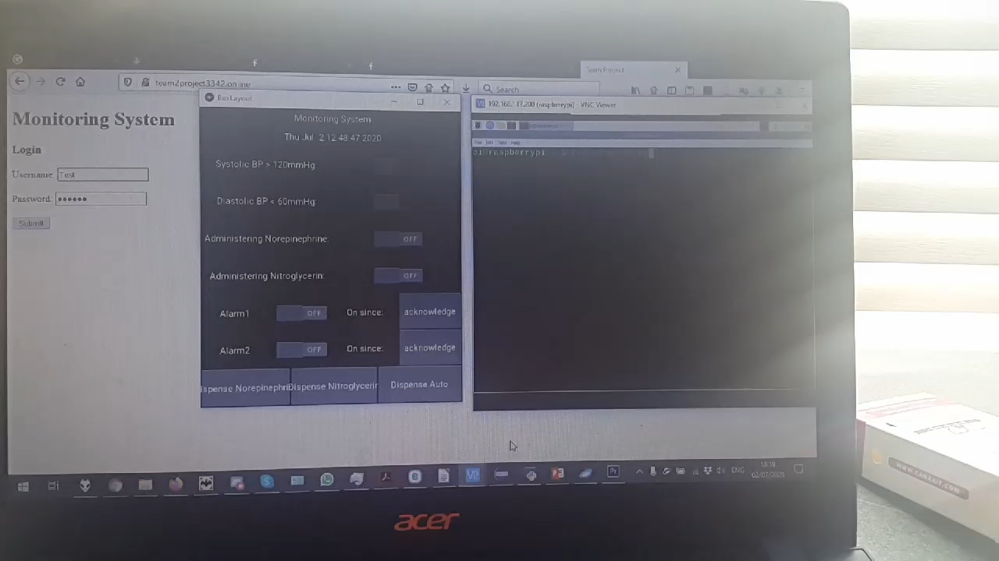
Video Demo

Slide 27
Conclusion
Despite the system is small, it might be easily extended by the adding various modules, because the code is flexible.

